Slide 1

Fee report of students
Under the guidance of
Mrs.pavithra
Submitted by,
T.SRAVANTHI

Slide 2
INTRODUCTION
The "fee report of Students" has been developed to override the problems prevailing in the practise manual system.
The system enables efficient storage of student records to properly manage the fee records of the students. And it also generate messages for due balances instudents fee.

Slide 3
objective
A fee report software where admin can add/view/delete accountant and accountant can add/view/edit/delete student, check due fee and logout.

Slide 4
Users of the System
Admin
Accountant
Student

Slide 5
Software Requirements
Eclipse IDE

Slide 6
HARDWARE REQUIREMENTS
OS: Windows 10 or above
RAM: 4GB or above

Slide 7
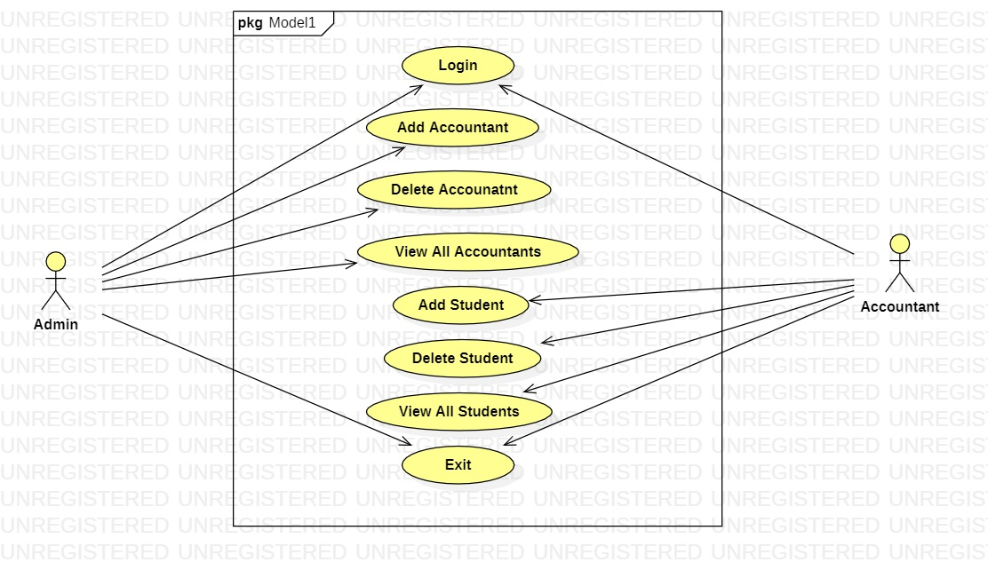
USECASE DIAGRAM

Slide 8
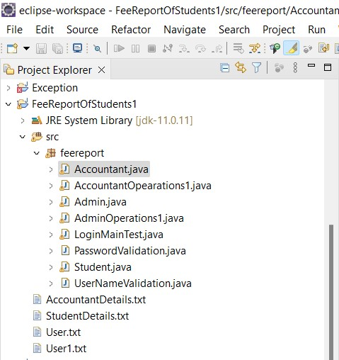

Slide 9
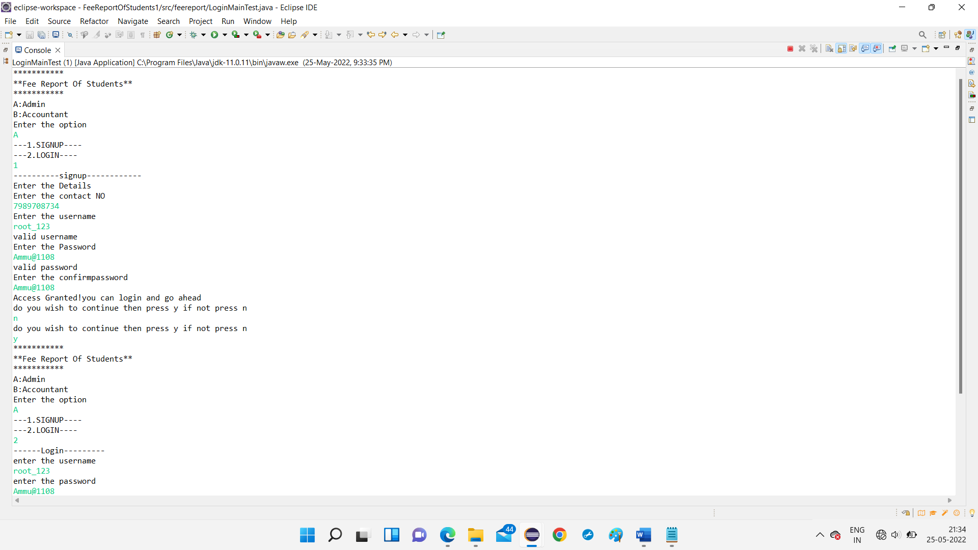
OUTPUT

Slide 10
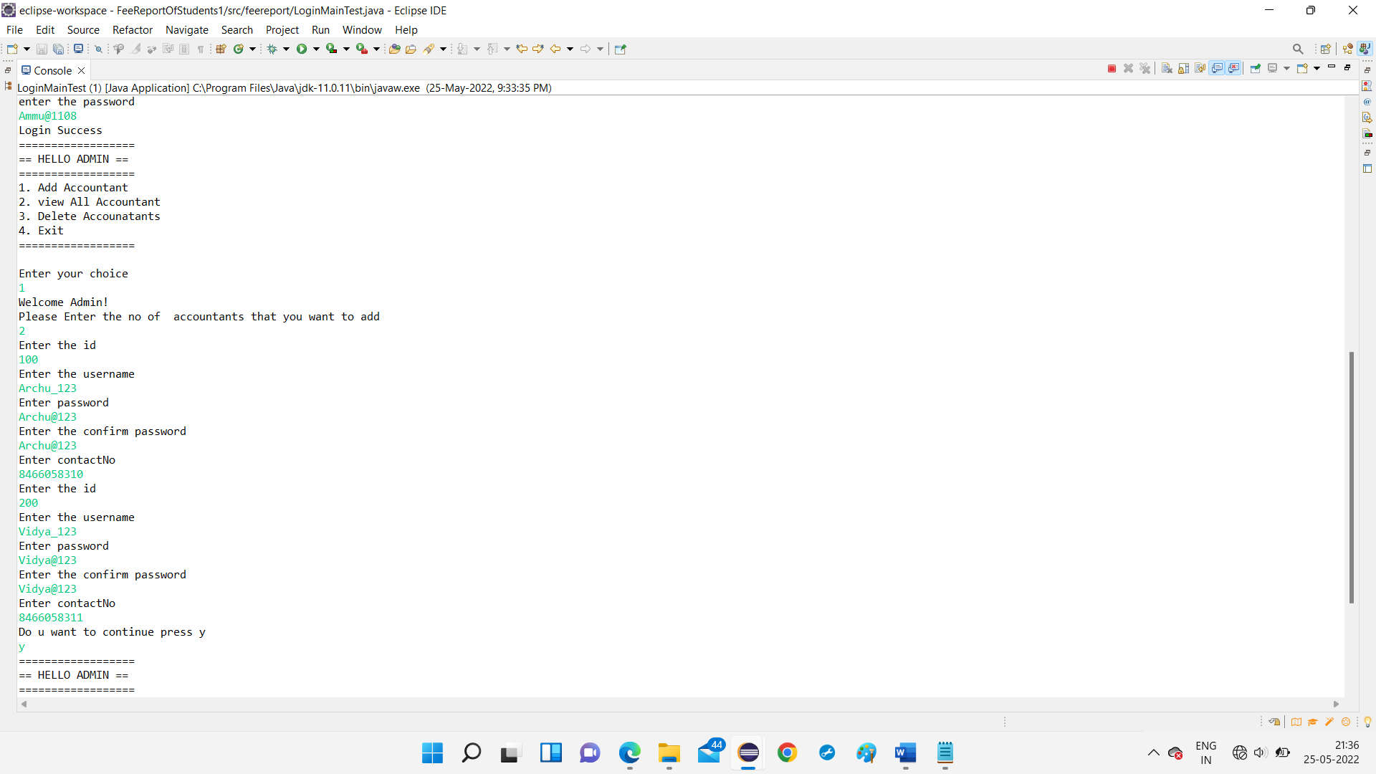

Slide 11
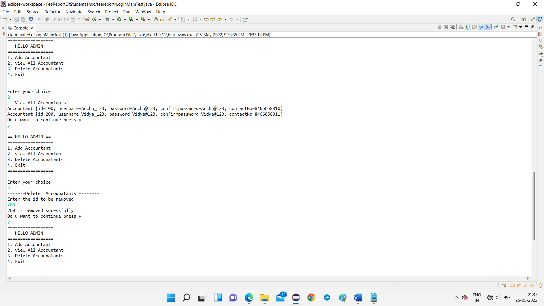

Slide 12
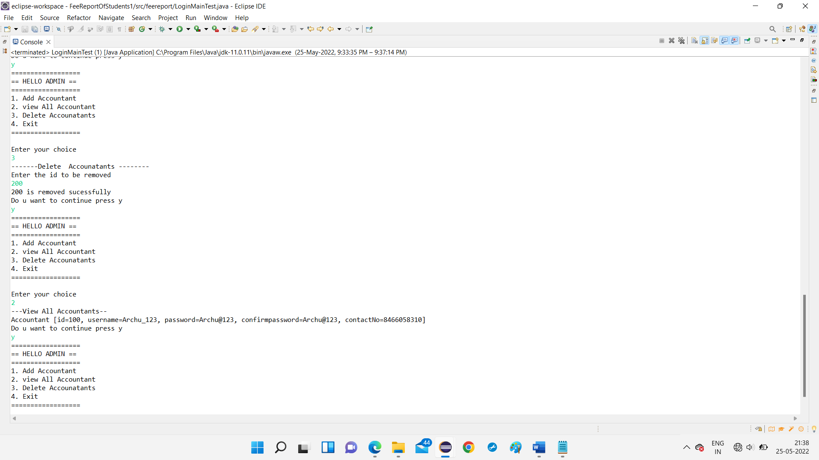

Slide 13
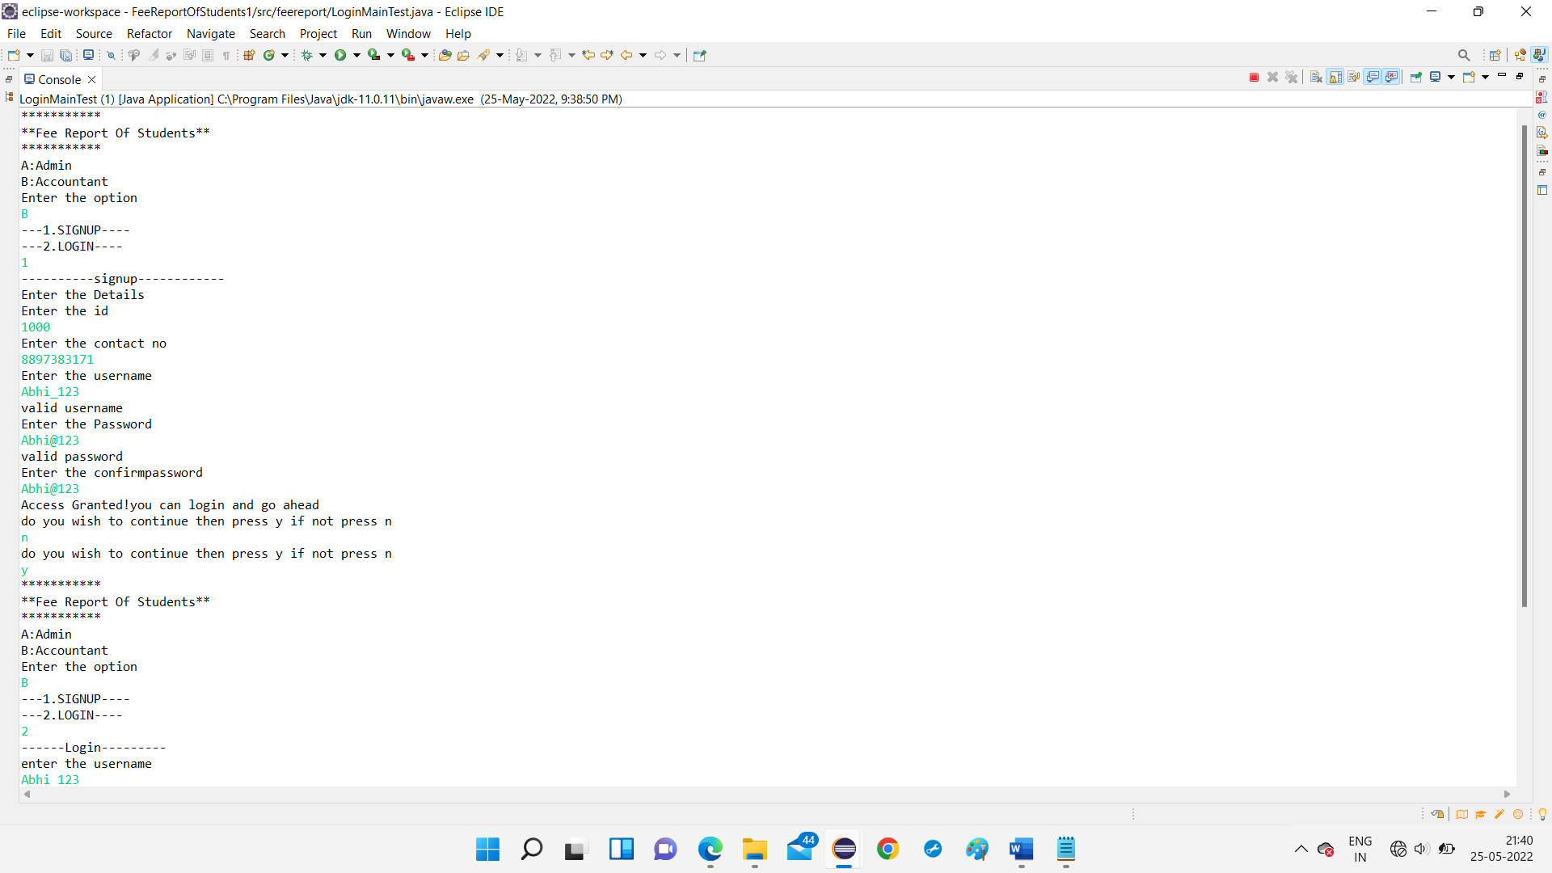

Slide 14
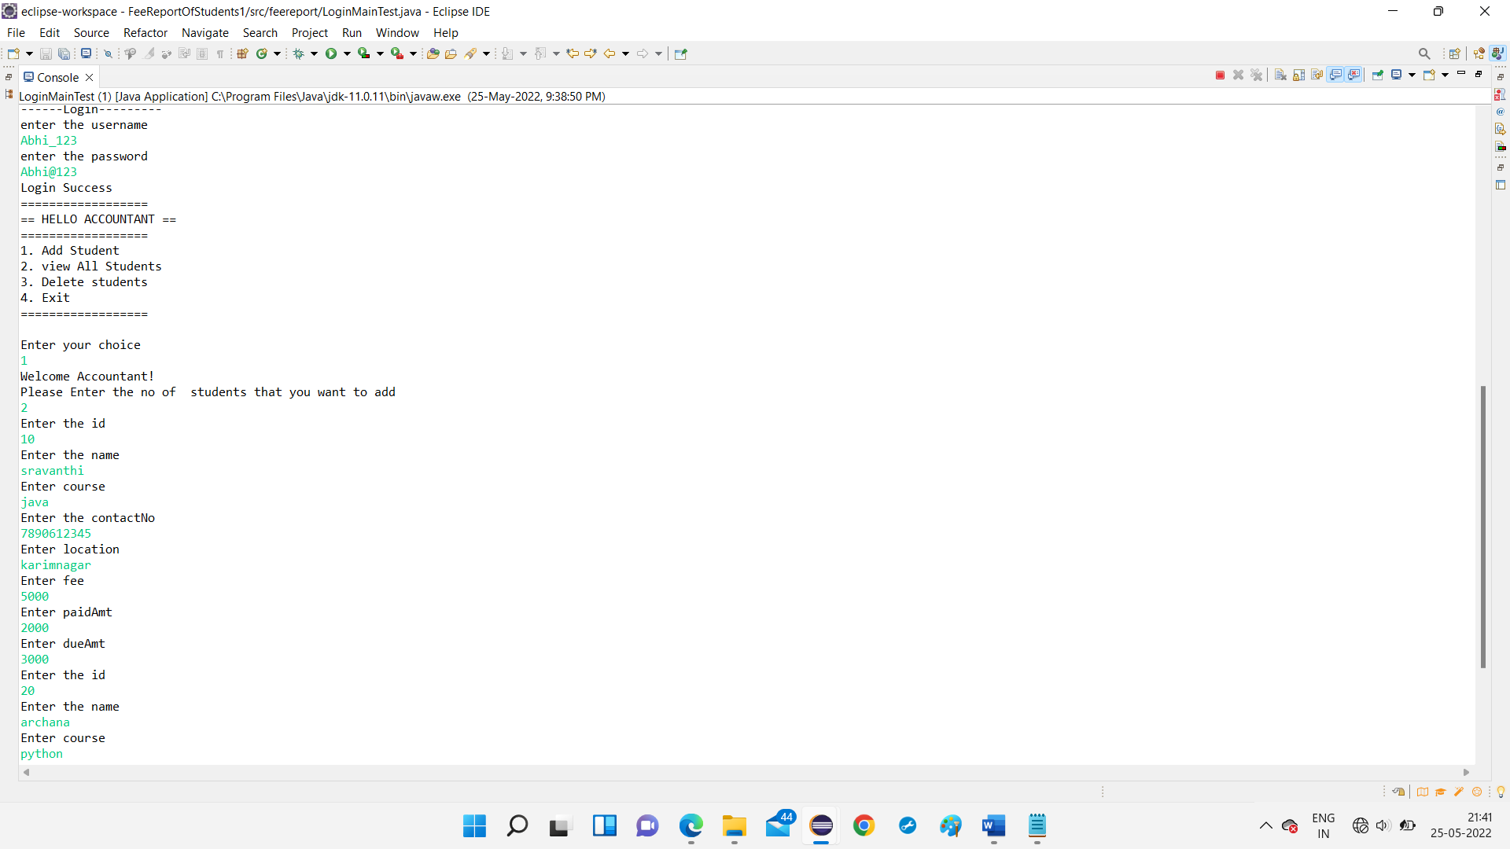

Slide 15
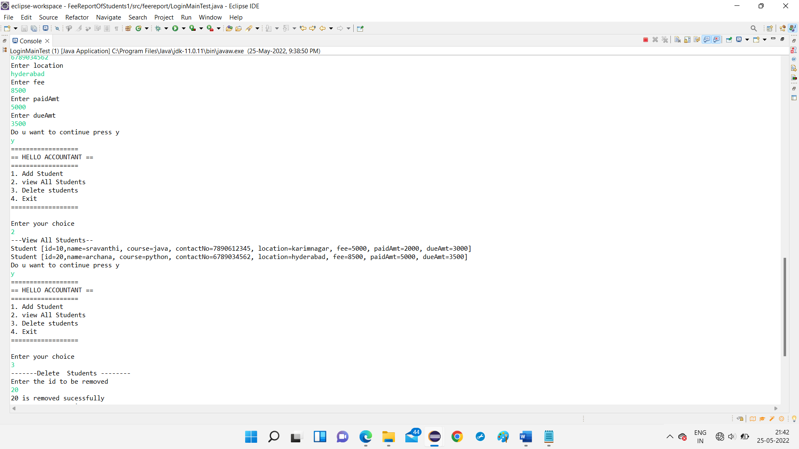

Slide 16
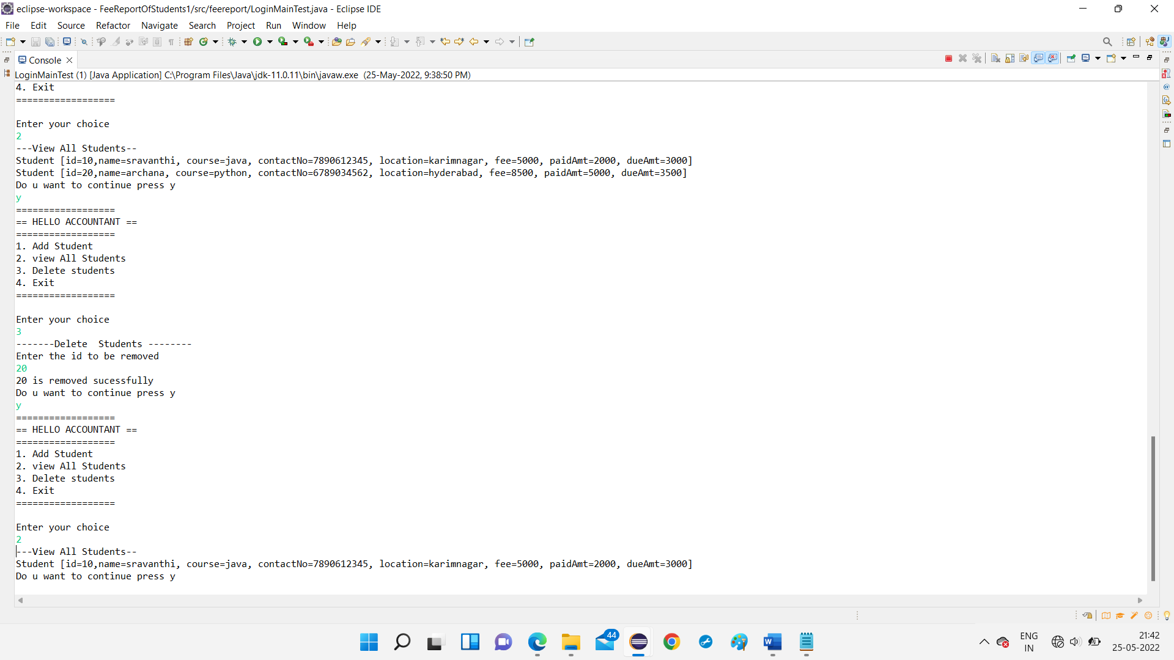

Slide 17
CONCLUSION
By implementing this project it will give more flexibility to the Accountant.
This code can actually provide a variety of options to Student and admin.
This code has verified using and tool and output has been achieved.
This system will provide fast support service to student and give fast response to student.
.

Slide 18
THANK YOU

